Slide 1
Personal Protective Equipment Authentication System
Joel Valleroy
Todd Gardiner
John Boone
Ben Heinrichs
Notes:
Joel

Slide 2
Overview
What is PPE and Why is it necessary?
How our Design Works
Goals
User Scenarios
Summary
Questions
Notes:
Joel

Slide 3
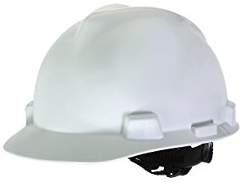
PPE - Personal Protective Equipment
Helmets
Boots
Gloves
Ear Plugs
Safety Glasses
Hazmat Suits
Notes:
Todd

Slide 4
Need for PPE Authentication System
Health/Safety:
Hard hats were worn by only 16% of those workers who sustained head injuries
Only 1% of approx 770 workers suffering face injuries were wearing face protection
Only 23% of the workers with foot injuries wore safety shoes or boots
About 40% of the workers with eye injuries wore eye protection
Ehstoday.com [1]
Notes:
Todd

Slide 5
More Needs for PPE Authentication System
Biggest reason for lack of wearing PPE is noncompliance.
According to an OSHA article, a recent survey said noncompliance to PPE protocols was around 89%. [1]
Our system would reduce that number.
Notes:
Todd also talk about people could also forget to wear PPE

Slide 6
NFC Tags
Range
Size
Cost
Uses
Notes:
Ben: also talk about privacy

Slide 7
Goals
Verify correct set of PPE for a specific area
Easy Setup - Manager
Easy Use - Employee
Notes:
Ben

Slide 8
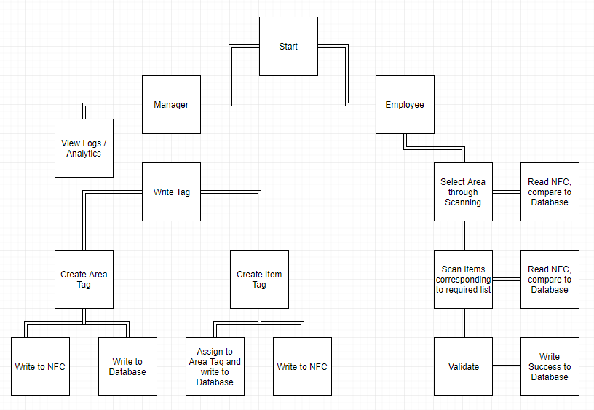
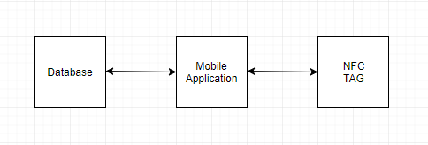
How the App Works
Notes:
Ben

Slide 9
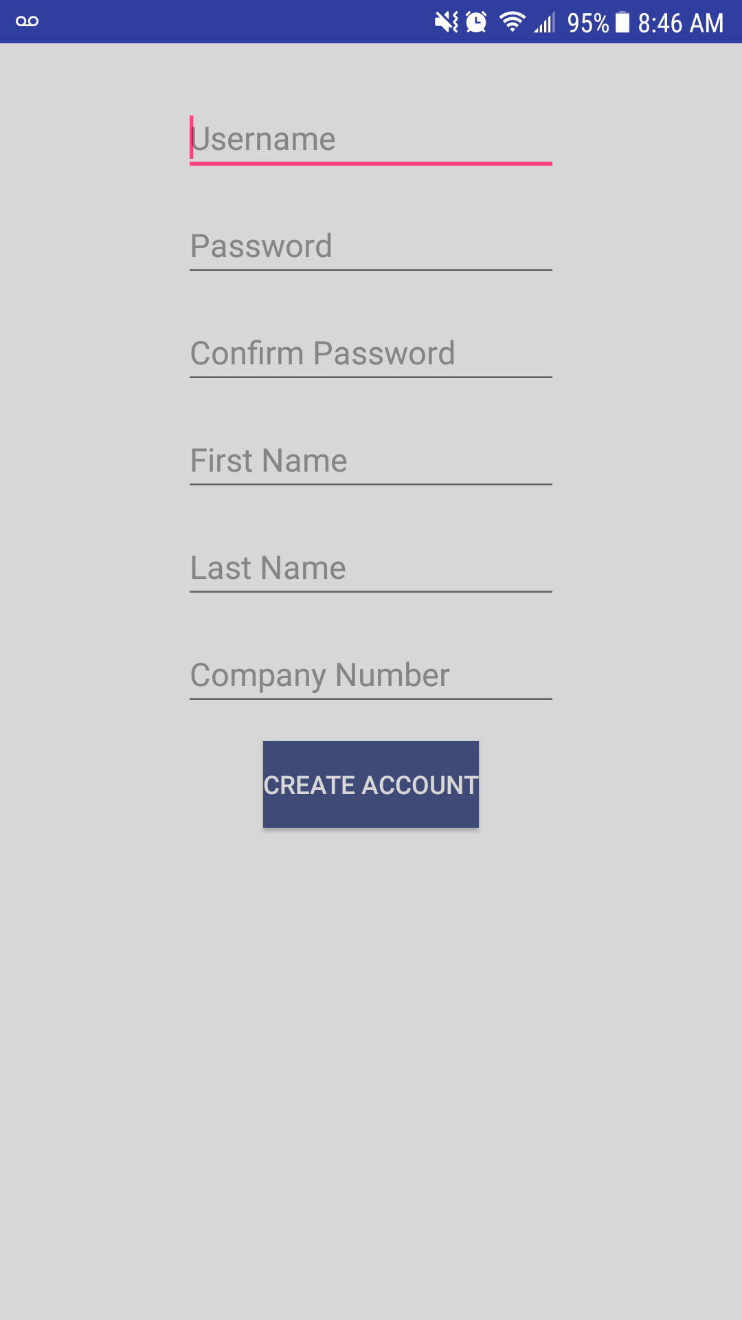
User Scenario
New user
Notes:
ben

Slide 10
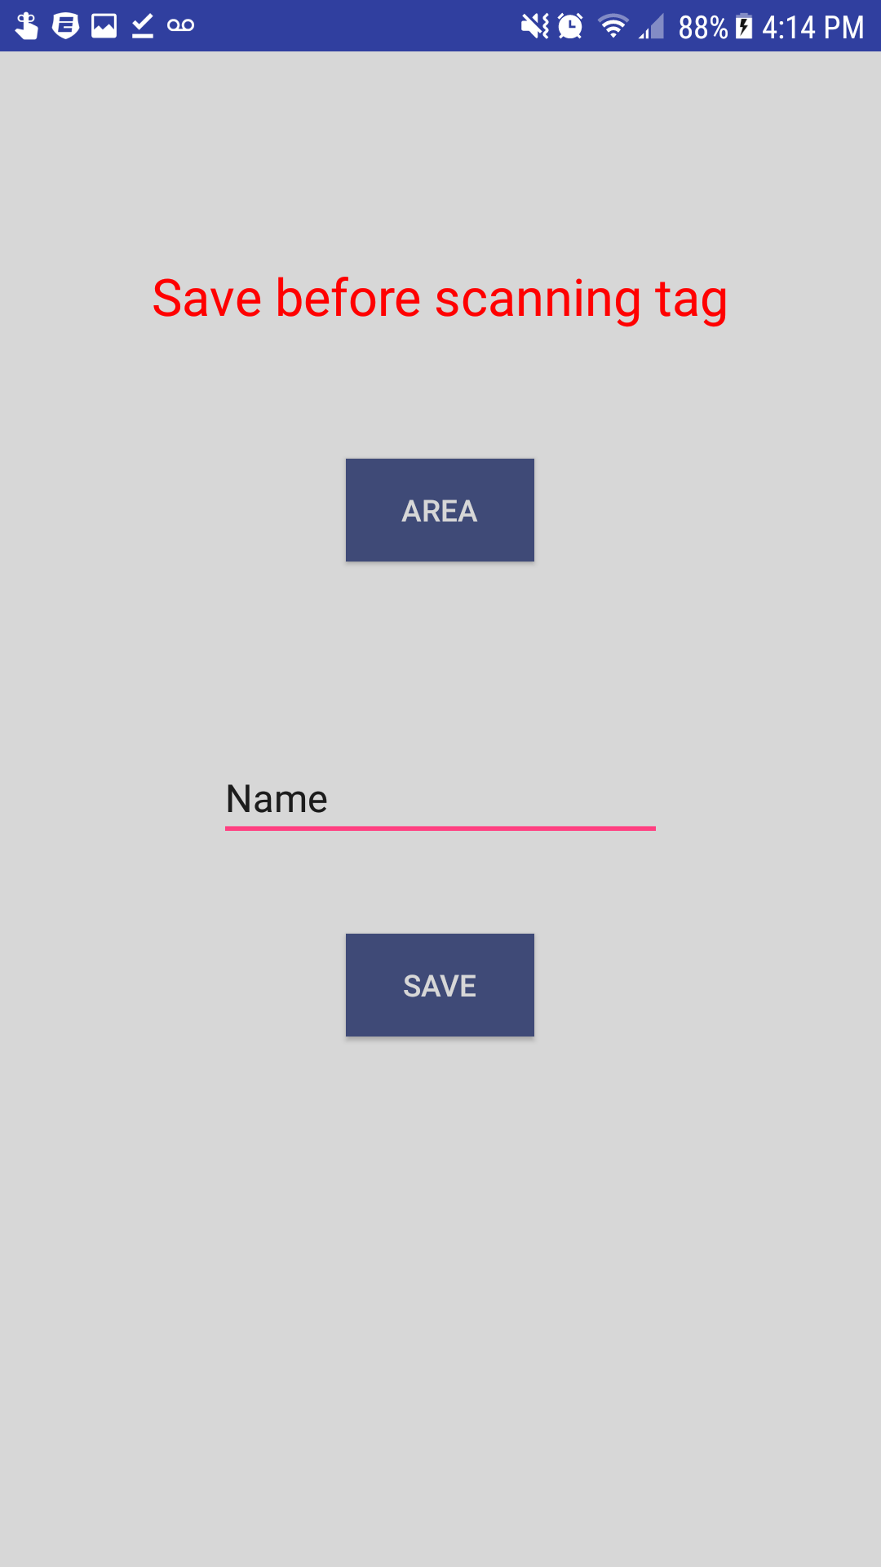
User Scenario
First, the manager can set up an AREA tag.
Notes:
John talk about how the app saves state when the save button is pushed displays what it is saved as then puts the data on the chip and into the database in the same call when the chip is scanned

Slide 11
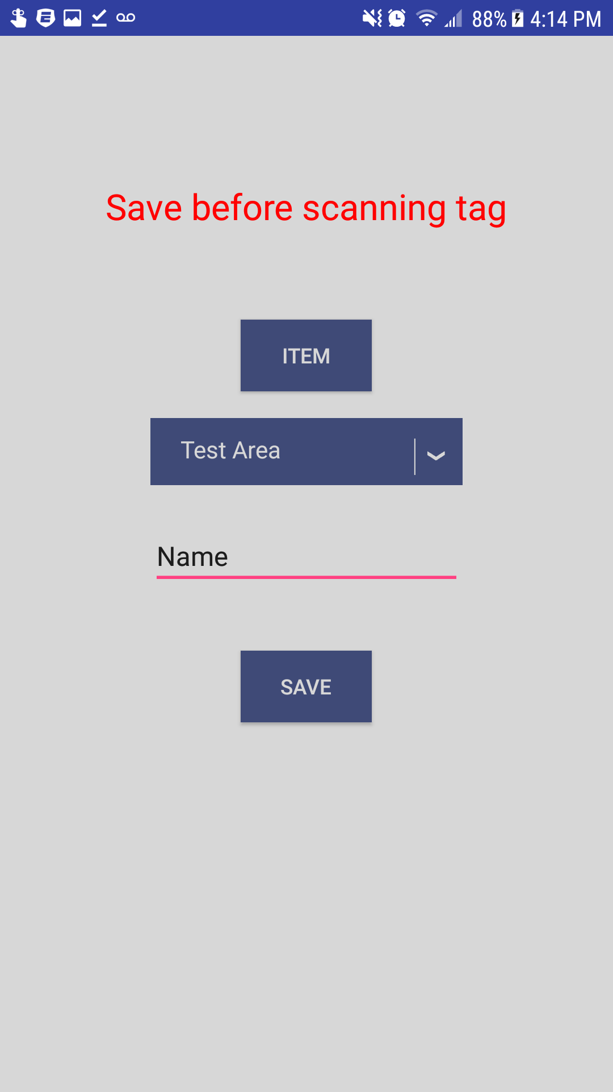
User Scenario
Manager creating item tag and assigning to area
Notes:
John

Slide 12
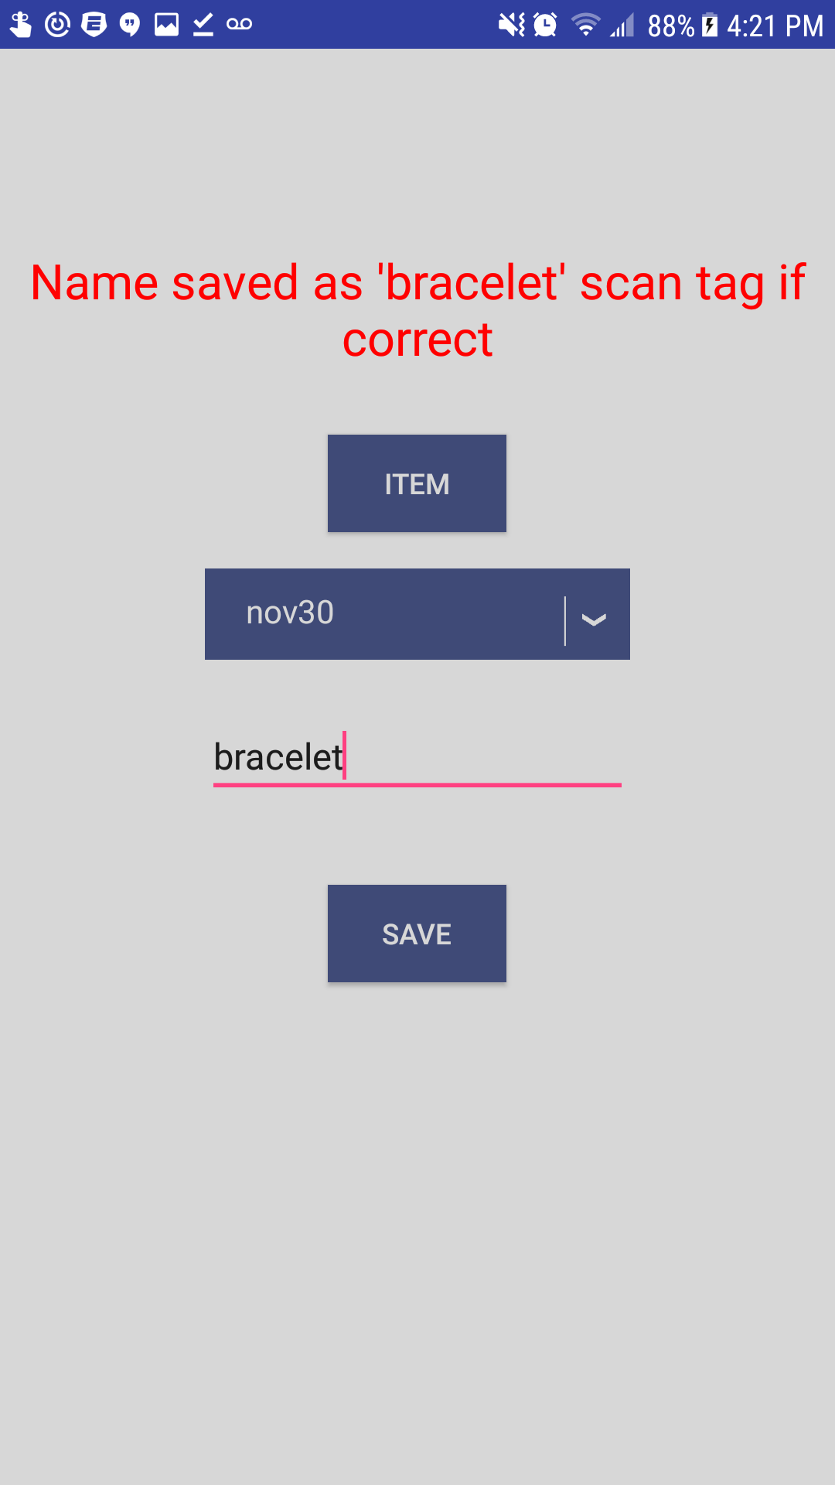
User Scenario
After hitting the save button

Slide 13
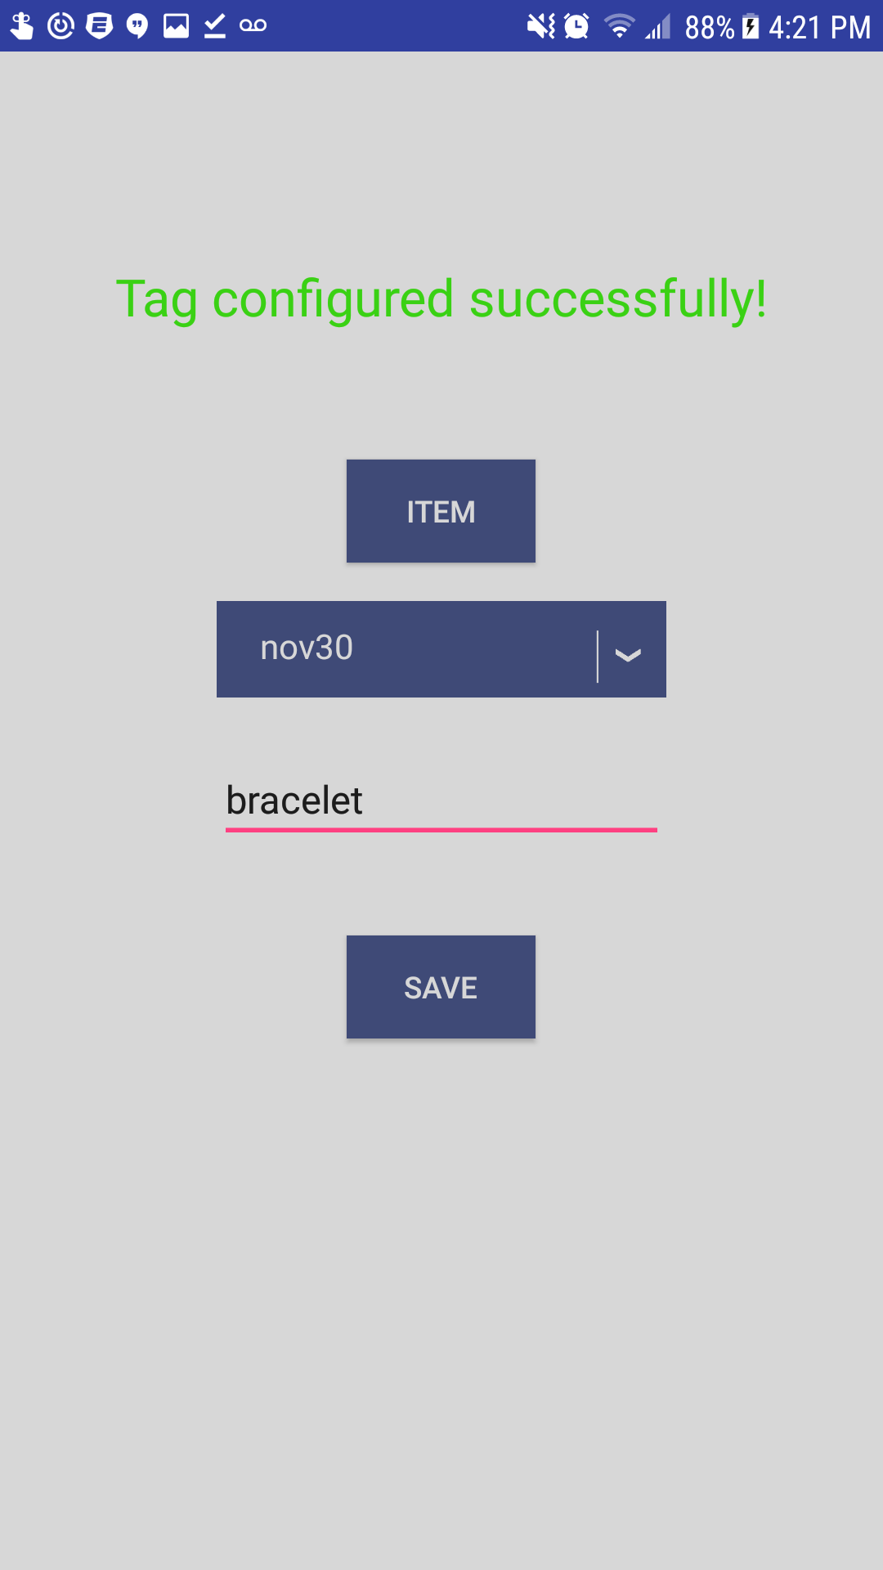
User Scenario
Success!
Notes:
John

Slide 14

User Scenario
Main Screen (user can scan area)
Notes:
John

Slide 15

User Scenario
Items required (not scanned in yet)
Notes:
John

Slide 16

User Scenario
Area pops up with items required in red
Items turn green as they are scanned in
Notes:
John

Slide 17

User Scenario
Success!
Notes:
John

Slide 18
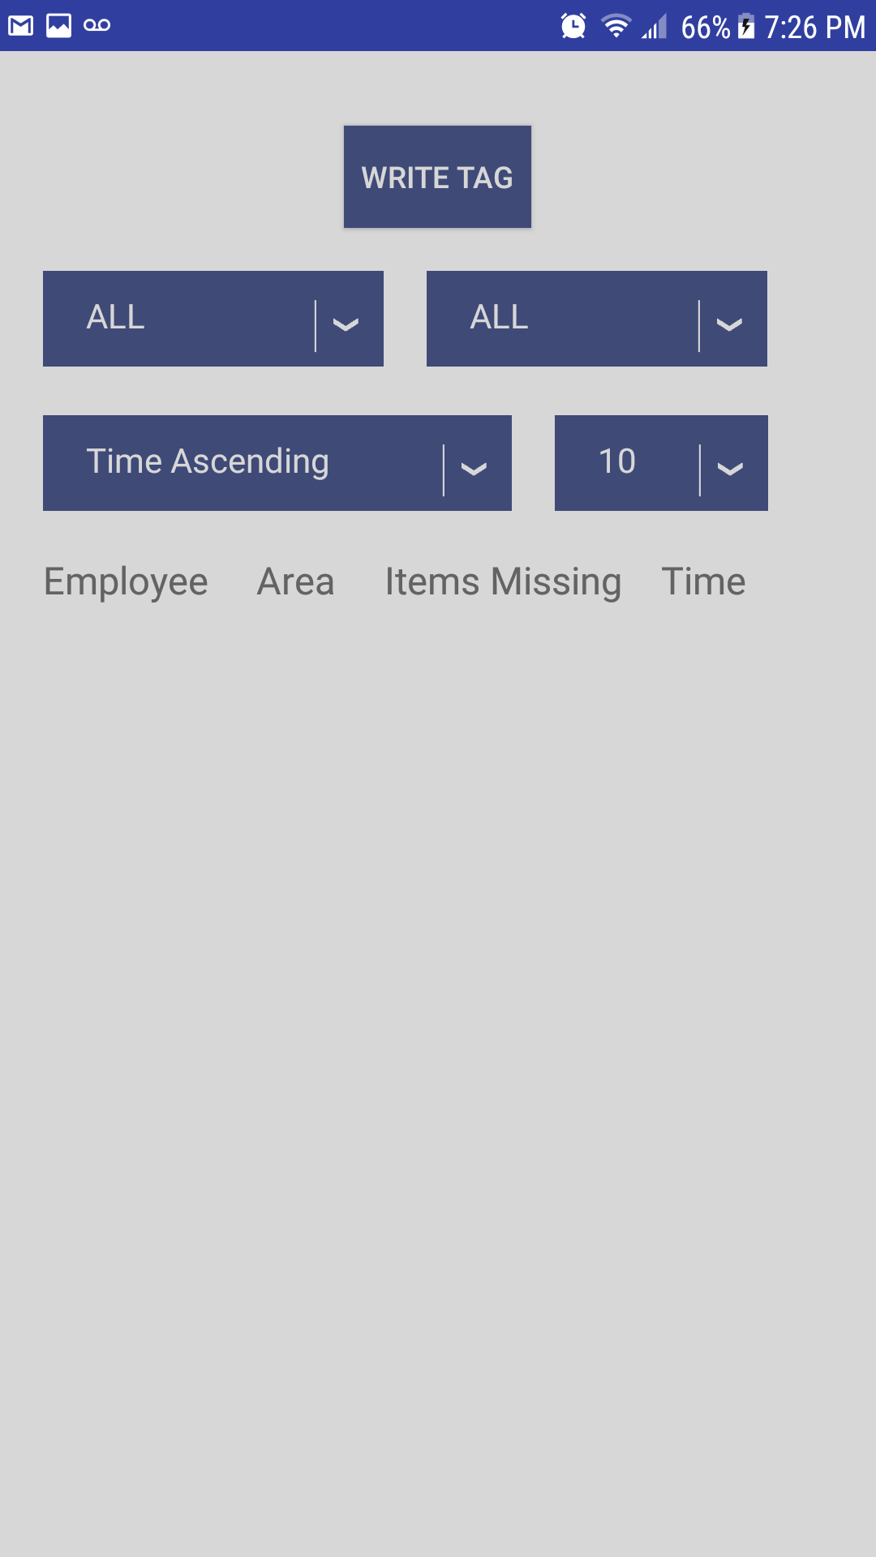
User Scenario
Manager log
Notes:
John: Admin page

Slide 19
Conclusion
Similar Tech
Marketing
Affordability
Development Issues / Review
Future Ideas (electronic lock, ID scan, timecards, warehouse inventory…)
Notes:
Joel

Slide 20
Source
http://www.ehstoday.com/ppe/hand-protection/workers-risking-injury-safety-equipment-6332
Notes:
Joel

Slide 21
Thank you!
Questions?
Notes:
Joel

